Slide 1
Overview of tonight’s class
Announcements
Quiz
Composite pattern
Midterm prep
State pattern
Observer pattern
Project overview
Animation
Tracking timeUML: Abstract classes and interface “lollipop” notation
Visio Demo (time permitting)

Slide 2
Announcements
Homework 1 is almost done being graded – grades should be up by around end of day Wednesday
Homework 2 grading will begin immediately afterwards
Midterm is NEXT WEEK! If you are an Online student, you may come in to class to take the test, but otherwise it will be available from Friday, October 14th – Tuesday, October 18th

Slide 3
Quiz

Slide 4
Composite pattern
An object that’s made up of multiple objects, which may in turn be made up of multiple objects. Think about a Tree structure.
Clients interact with a single object and a composition of objects the same way.

Slide 5
Example
In Windows, a Folder can contain a list of files and/or Folders (recursive). When searching, you don’t manually go into each folder and search. You search some root folder, and it will propagate search results from its files and subfolders

Slide 6
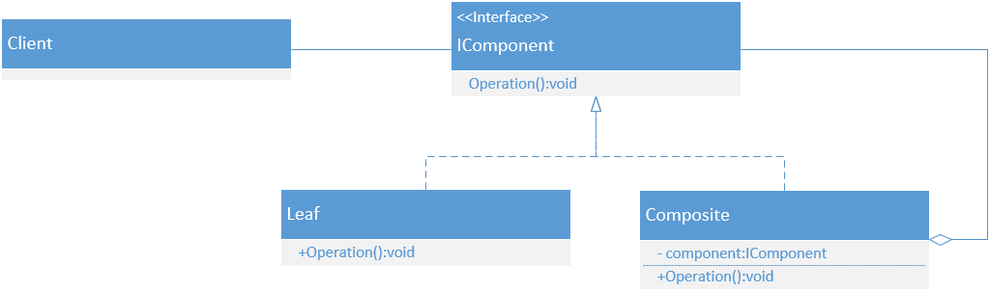
Example uml

Slide 7
Composite code demo
You have a File class, a Folder class, and an interface IFileSystemItem.
Set up the following folder structure:
Root
| - Folder 1
| | - Folder 2
| | | - File 1
| | - File 2
|- File 3

Slide 8
Composite code demo
Calculate the total size of the folder structure

Slide 9
Composite code demo
Draw an object diagram showing the current structure

Slide 10
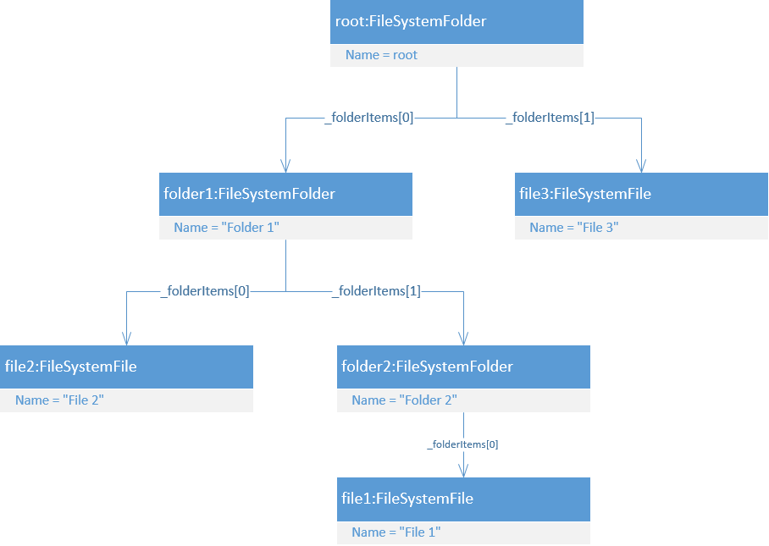
Object diagram

Slide 11
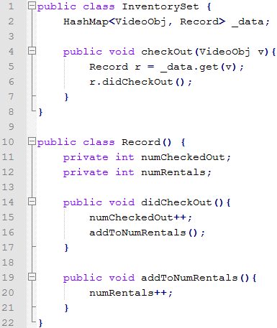
Draw a sequence diagram for the following code:

Slide 12
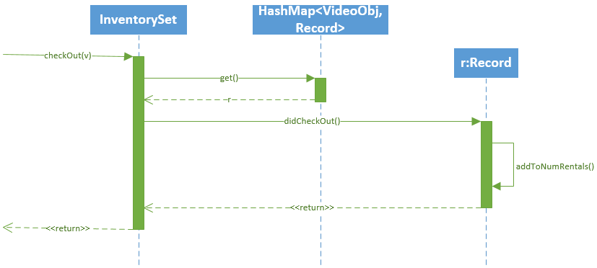
Sequence diagram

Slide 13
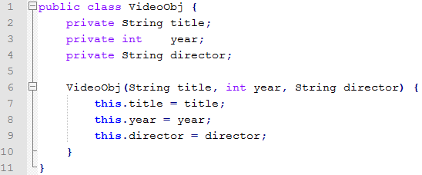
Read the code
If there were methods that relied on title, director, and year, what are some potential issues you could foresee based on this code snippet?

Slide 14
Write a unit test
We want to change this code so that if the director is null or whitespace, it throws an IllegalArgumentException.
Write the unit test to test the change.

Slide 15
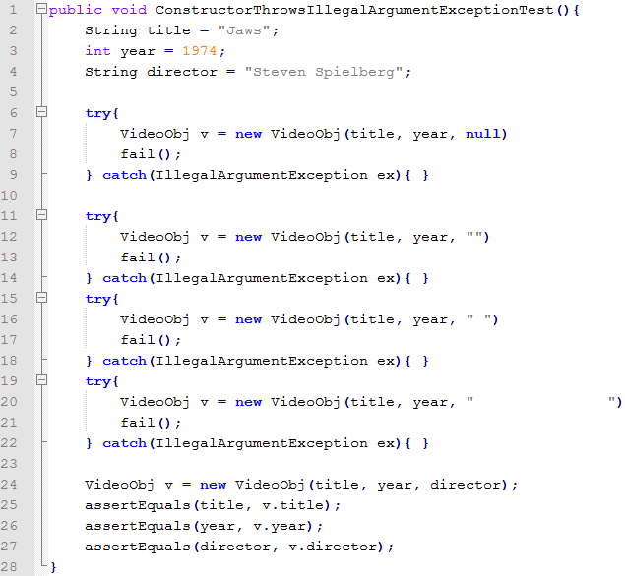
Unit test

Slide 16
When would you use Factory vs Builder?
Factory: When you are creating a simple, mutable object
Builder: when you are creating a complex, immutable object

Slide 17
If-else demo
What’s wrong with the design in this code?

Slide 18
Composite builder demo
One of the points of the Composite pattern is that the client doesn’t know the structure of the Composite object; it acts as one single object. Modify the Composite demo we did earlier to use a Builder pattern to put the Composite object together. The results should be the same as the first Composite demo.

Slide 19
State pattern
State pattern encapsulates certain functionalities into classes, similar to Strategy. Their UML diagrams are almost the same
The differences are: States are managed inside of the class that has the state
Strategies are provided by external clients
Strategy is used to provide behavior to a class instead of subclassing
State is used as an alternative to having a bunch of if/else statements in your code

Slide 20
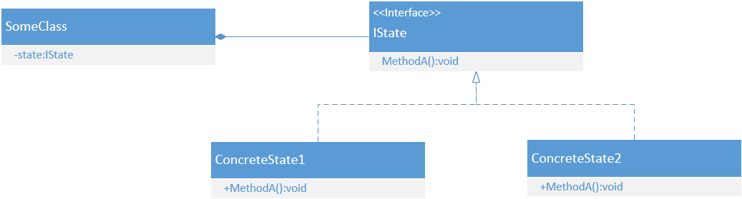
State UML diagram

Slide 21
State pattern example
Write a Day class that will print out the day of the week of it’s internal date. The weekends should be in ALL CAPS and the weekdays should be lower case

Slide 22
State pattern example
Now modify the code so that the alarm will go off on weekdays and not weekends.

Slide 23
Observer pattern
A subscribe/publish pattern
One or more objects subscribe to an object to be automatically notified when some event occurs
One common scenario is in a GUI application, multiple objects might subscribe to a button to be notified when the button is clicked

Slide 24
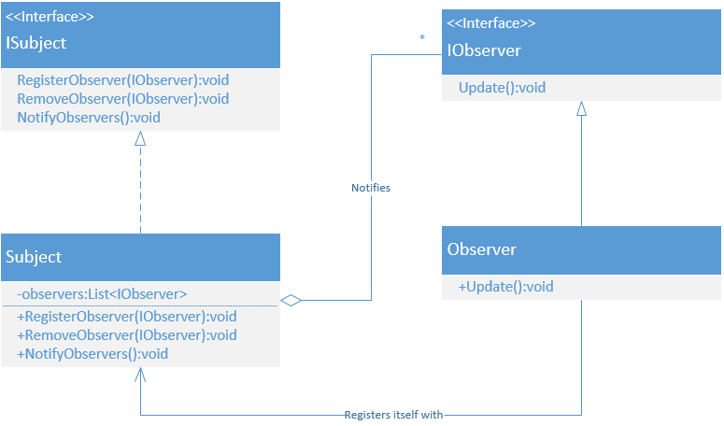
Observer pattern uml

Slide 25
Observer code demo
We want to add an event to the Count class so every time the count is divisible by 10, an object will print out to the console.

Slide 26
Observer code demo
Add another observer that will print out “I’m doing something” every 10 increments.

Slide 27
Project overview
http://fpl.cs.depaul.edu/jriely/450/notes/notes-final-project-000.html

Slide 28
Animation in Java
http://fpl.cs.depaul.edu/jriely/450/lectures/class-05-025.html

Slide 29
Tracking time
You will need to track your time in your project
Measure time.
Measure bugs.
I will also ask you to try to predict how much time you will spend. You can see how accurate your predictions are. With experience, you will get better at predicting.

Slide 30
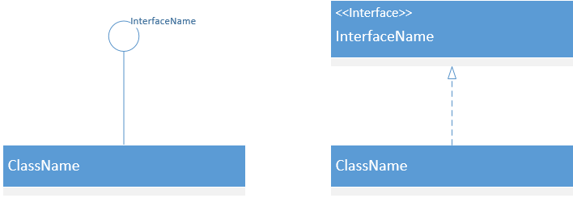
Uml diagram: Interface implementation
Ball and socket:

Slide 31
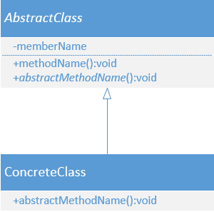
Uml diagram: abstract class
Abstract members are italicized

Slide 32
Visio demo

